Slide 1
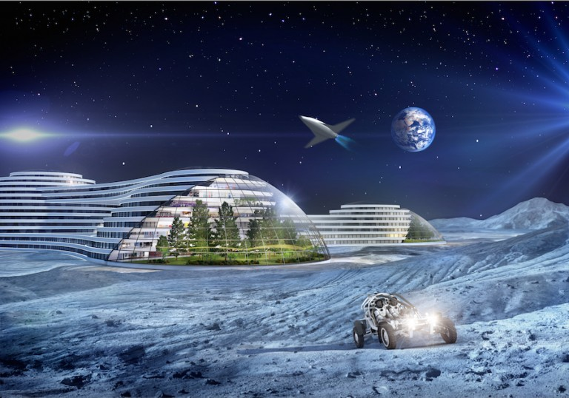
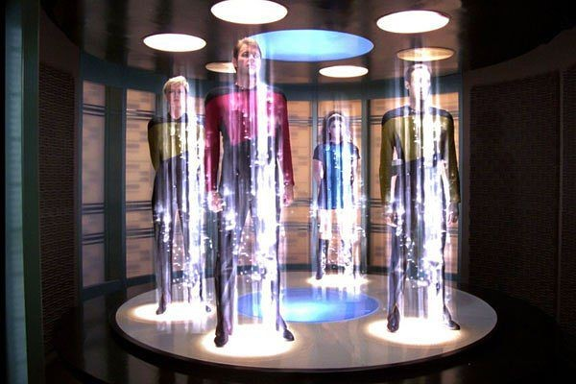
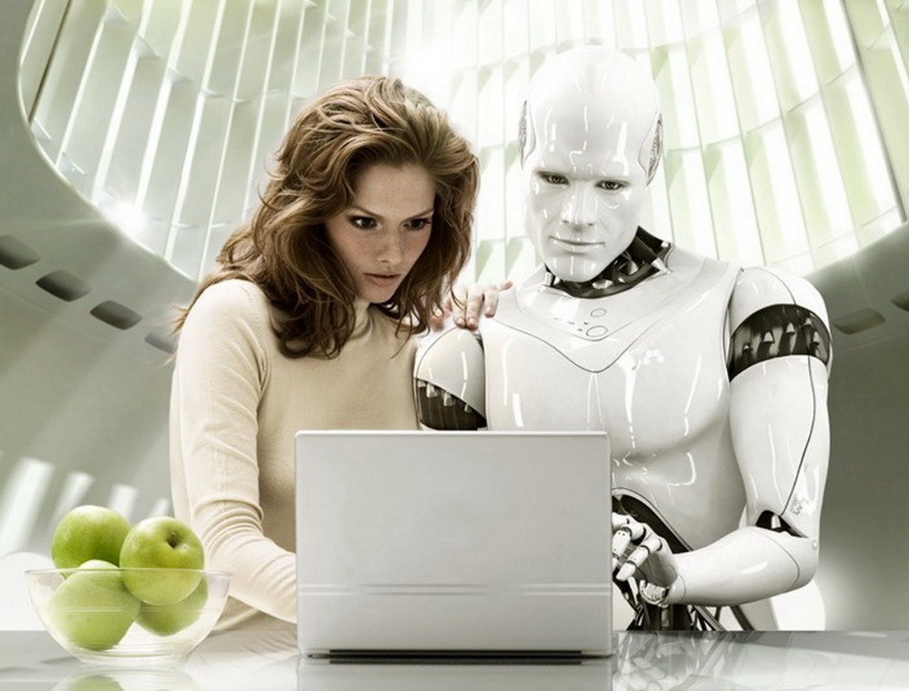
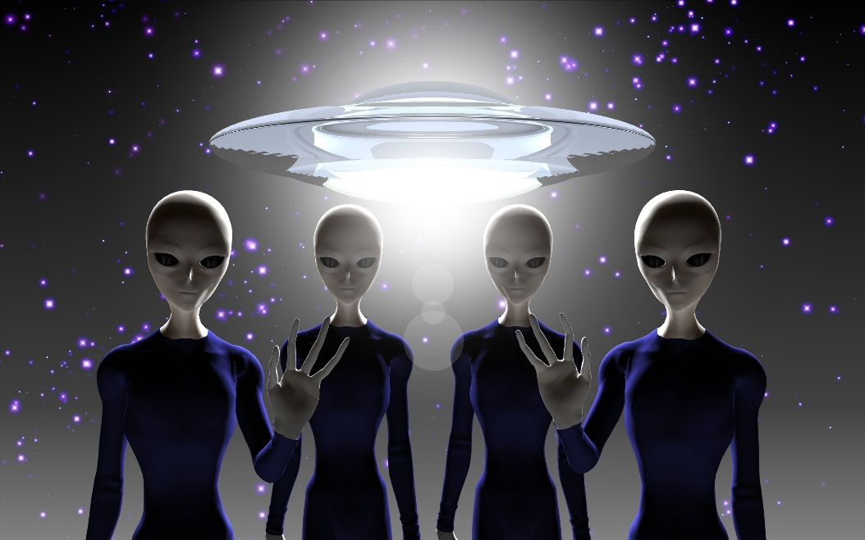
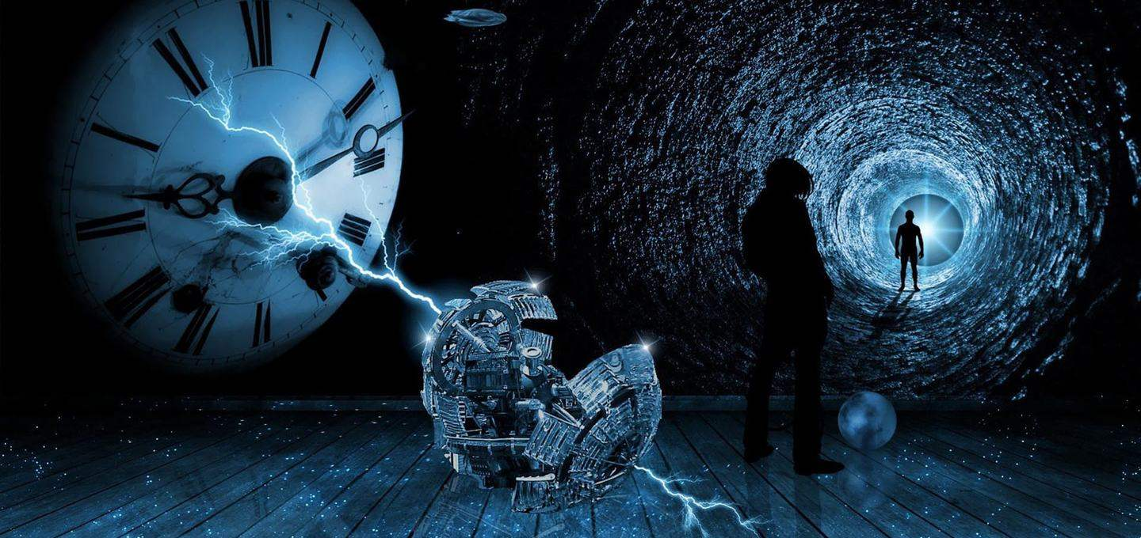

Slide 2
What does the future hold for us?
Are you optimistic or pessimistic about future?

Slide 3
What do you think your life will be like in 2050?

Slide 4
Future tenses
Will be Ving
This time next century people will be travelling in space.
Will have V3
By the end of the century we will have built a time machine
Will have been Ving
By the year 2070 people will have been living on the Moon for 20 years.

Slide 5
By the year
2050
Nearly half of the Amazon rainforest (be) deforested.
Humans (merge) (сливаться) with machines.
2056
Global average temperatures (rise) by 3°C*.
Many well-known animal species (go) extinct
2050-2059 timeline contents

Slide 6
30 years from now I/people/robots will be ……ing ….
By the time I am 75,
I/people…. will have been …..ing for ..
Complete the sentences

Slide 7
What advantages and disadvantages these technological advances and inventions may have
Robots
Time machine
Invisibility cloak
Living forever
Space colonies
Clones of extinct animals
Contacts with an alien civilization

Slide 8
What advantages and disadvantages these technical advances and inventions may have
Advantages | Disadvantages

Slide 9
Are you optimistic or pessimistic about future?
Will life in the future be better, worse or the same as now?

